Slide 1
Recommendation engine
Manikandan muthiah

Slide 2
SYNOPSIS
Challenge
Building a recommendation engine for 30 unique cloth brands based on user ratings
Issues
73% data not having brand name in the given dataset.
Background
We have a clothes rating dataset with item id, user id, rating, brand. For our recommendation engine, we considered brand, rating and user id and finding correlation between the brands using user ratings.

Slide 3
Problem Statement and Solution
Problem Statement
Building a recommendation engine for 30 unique online cloth brands based on user ratings.
Dataset provided:
We have a clothes dataset with item id, user id, rating, timestamp, model attribute, brand, year, user attribute, split.
Consideration
For our recommendation engine, we considered brand, rating and user id and finding correlation between the brands using user ratings.
Solution
Finding correlation between the brands using user ratings so that we can recommend products to the user based on similar purchase.

Slide 4
Technology Used
Python Pandas

Slide 5
Solution Architecture
Input Dataset
Modcloth.csv
Data imputation
Correlation matrix

Slide 6
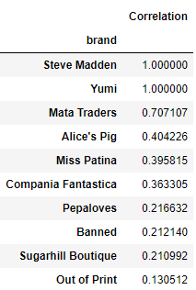
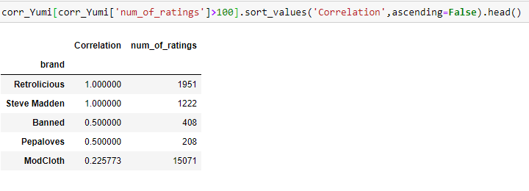
Prototype/ MVP Demo Video/Screenshots
ClothMod Correlation
Yumi Correlation

Slide 7
Challenges Faced
Dataset has very less valid brands, so need to drop lot of records.

Slide 8
THANK YOU

